Slide 1
Performance via Complexity
Need for Architectural Innovations
© 2018 L. V. Kale at the University of Illinois Urbana-Champaign
Notes:
1

Slide 2
Outline
Components of a basic computer
Memory and caches
Brief overview of pipelining, out of order execution, etc.
Theme: Modern processors attain their high performance by paying in increased complexity
The programmers, mainly, have to deal with the complexity and performance variability that results from it

Slide 3
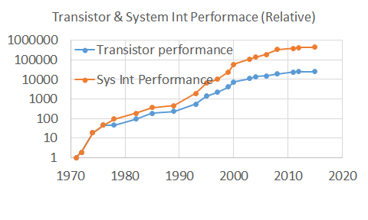
Need for Architectural Innovation
The computers didn’t become faster just relying on Moore’s law:
E.g., switching speeds increased at only a moderate rate
So, to keep making clock speeds faster, architectural innovations were needed
(S. Borkar, Personal Communication, February 24, 2018)
Notes:
Between 1976 to 2005, transistor speeds go up by 1200 or so, while the integer performance, which roughly correlates to clock speed went up 10,000 fold.

Slide 4
Components of a Stored-Program computer
So, let us review our schematic of a stored program computer to see where innovations were added
Instruction Memory
Data Memory
PC (Program Counter)
Move to the next location
Register set
CPU
Register name
Instruction
Data

Slide 5
The Stored-Program Architecture
The processor includes a small number of registers
With dedicated paths to ALU (arithmetic-logic unit)
In modern “RISC” processors since mid-1980s
All ALU instructions operate on registers
Only way to use memory is via:
Load Ri, x // copy content of memory location x to Ri
Store Ri, x // copy contents of Ri to memory location x
Before 1985, ALU instructions could include memory operands

Slide 6
Control Flow
Instructions are fetched from memory sequentially
Using addresses generated by the program counter (PC)
After every instruction, the PC is incremented to point to the next instruction stored in memory
Control instructions like branches and jumps can directly modify PC

Slide 7
Datapath - Schematic
Control Unit
Datapath
WR
DA
AA
D
Register file
A B
Branch
Control
V
C
N
Z
PC
BA
constant
ADRS
Instruction
RAM
1 0
Mux B
MB
FS
A B
ALU
G
ADRS DATA
Data RAM
OUT
Instruction Decoder
V
C
N
Z
MW
DA AA BA MB FS MD WR MW
0 1
Mux D
MD

Slide 8
Obstacles to Speed
What are the possible obstacles to speed in this design?
Long chain of gate delays
“Floating point” computations
Slow.. I mean really S…l…o…w memory!!
Virtual memory and paging
The theme for this module:
Overcoming these obstacles can lead to significant increase in complexity, and can make performance difficult to predict and control

